Slide 1
Retrieval Augmented Approaches in NLP
Hongkun Hao (郝宏坤)
Shanghai Jiao Tong University

Slide 2
Paper list
Leveraging Passage Retrieval with Generative Models for Open Domain Question Answering EACL 2021
Efficient Cluster-Based k-Nearest-Neighbor Machine Translation ACL 2022
Cross-Lingual Phrase Retrieval ACL 2022

Slide 3
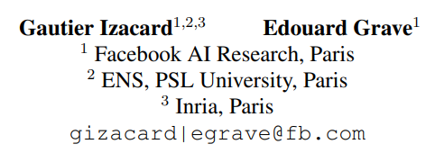
Leveraging Passage Retrieval with Generative Models for Open Domain Question Answering
Challenges
Models without relying on external knowledge contains billions of parameters.
This paper investigates how much this method could benefit from having access to an external source of knowledge, such as Wikipedia

Slide 4
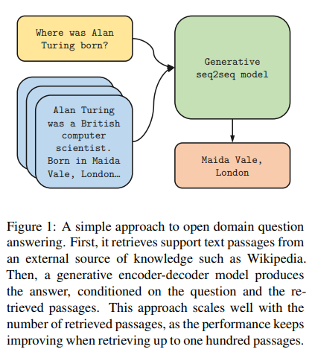
Methods —— Overview
It proceeds in two steps:
First retrieving support passages,
Then processing them with a sequence to sequence model.

Slide 5
Methods —— Retrieval
Two methods: BM25(1995. Okapi at TREC-3. NIST Special Publication
Sp.) and DPR(2020. Dense passage retrieval for open-domain question answering)
In BM25, passages are represented as bag of words, and the ranking function is based on term and inverse document frequencies.
In DPR, passages and questions are represented as dense vector representations, computed using two BERT networks. The ranking function is the dot product between the query and passage representations.

Slide 6
Methods —— Reading
Generative model is based on a sequence-to-sequence network, pretrained on unsupervised data, such as T5 or BART.
The model takes as input the question, as well as the support passages, and generates the answer.
More precisely, each retrieved passage and its title are concatenated with the question, and processed independently from other passages by the encoder. We add special tokens question:, title: and context: before the question, title and text of each passage.
Finally, the decoder performs attention over the concatenation of the resulting representations of all the retrieved passages.
The model thus performs evidence fusion in the decoder only, and we refer to it as Fusion-in-Decoder.

Slide 7
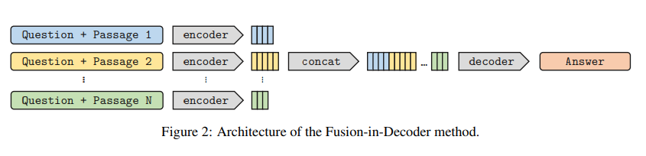
Methods —— Analysis
Processing passages independently in the encoder allows to scale to large number of contexts, as it only performs self attention over one context at a time.
This means that the computation time of the model grows linearly with the number of passages, instead of quadratically

Slide 8
Experiment —— Settings
Datasets: NaturalQuestions, TriviaQA, SQuAD v1.1
Technical details:
initialize models with the pretrained T5 models, fine-tune the models on each dataset independently.
Passages are retrieved with DPR for NQ and TriviaQA, and with BM25 for SQuAD.

Slide 9
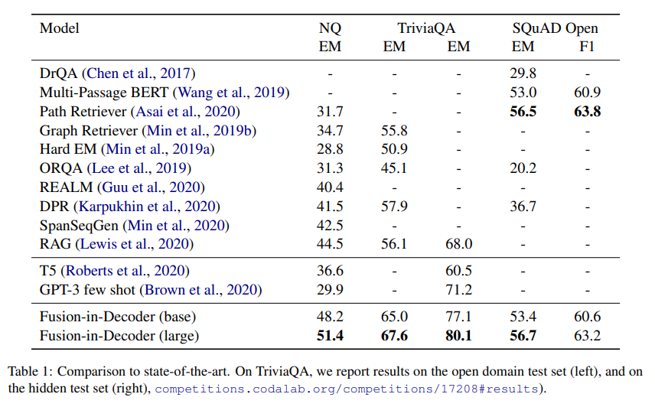
Experiment —— Results

Slide 10
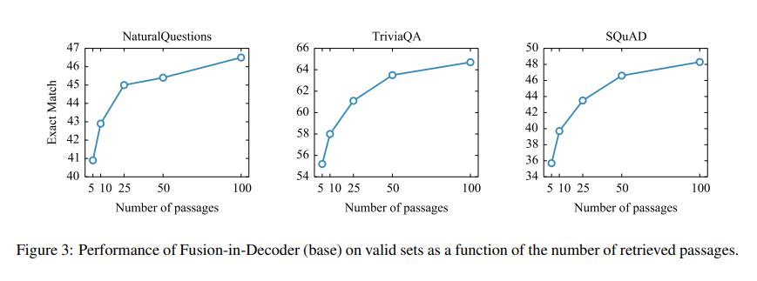
Experiment —— Analysis
Scaling with number of passages
this is evidence that sequence-to-sequence models are good at combining information from multiple passages.

Slide 11
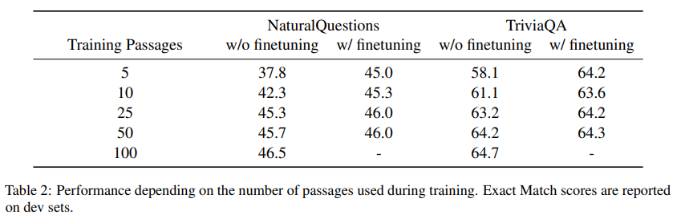
Analysis——Impact of the number of training passages
In the previous section, the model was trained and evaluated with the same number of passages. To reduce the training computational budget, a simple solution consists in training the model with fewer passages.
In Table 2, we report the performance obtained by training with different numbers of passages, while testing with 100 passages.
reducing the number of training passages leads to a decrease of accuracy. Further, we propose to finetune the previous models using 100 passages for 1000 steps.

Slide 13

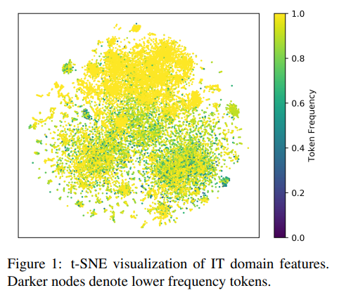
Efficient Cluster-Based k-Nearest-Neighbor Machine Translation
Challenges
kNN retrieval is at the expense of high latency.
Feature distribution of a datastore is in the overlapped area.

Slide 14
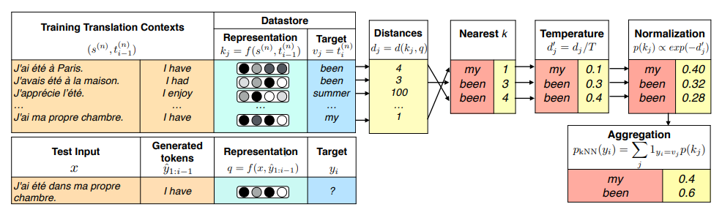

Background—Nearest Neighbor Machine Translation

Slide 15


Background—Adaptive Nearest Neighbor Machine Translation
Challenges: kNN-MT simply retrieves a same number of nearest neighbors for each target token, which may cause prediction errors.
Methods: introduce a light-weight Meta-k Network to estimate the importance of utilizing different ks k∈S where
Details: for each neighbor(h_i, v_i), caculate distance d_i, the count of distinct values in top i neighbors c_i. Denote d=(d_1,…,d_K) and c=(c_1,…,c_K) .

Slide 16
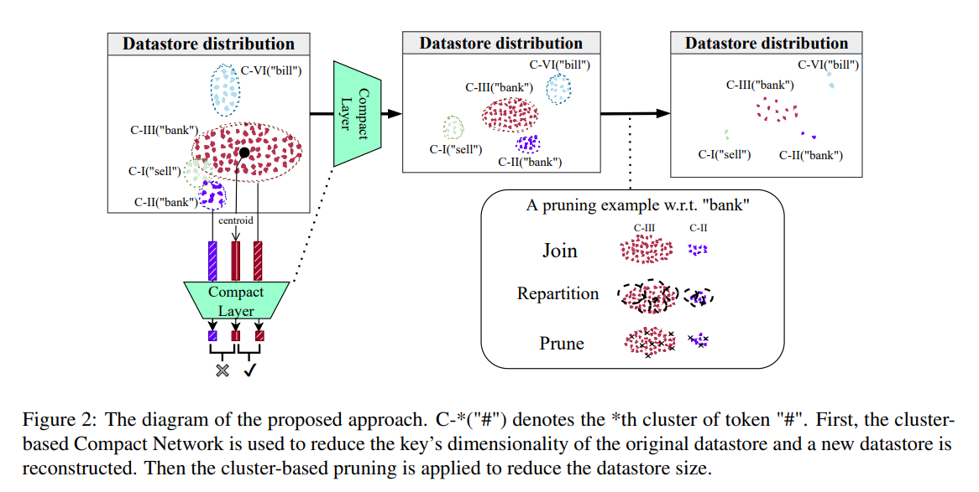
Methods —— Overview

Slide 17

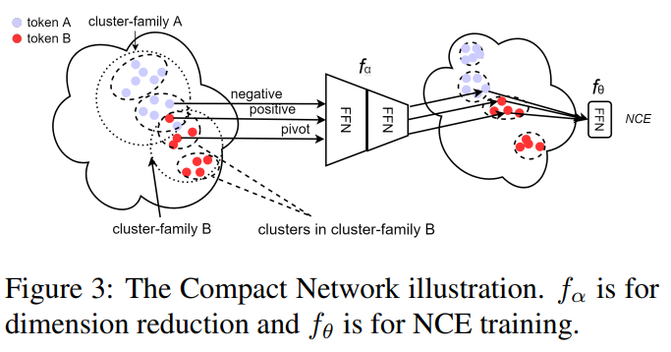

Methods——Cluster-Based Feature Compression
To address the issues of semantic distribution, propose a one-plus-one Compact Network on top of the pretrained NMT model.
1. create the datastore.
2. conduct target-side clustering for the representations. cluster family: resulted clusters from the same value.
3.
4. the last layer f_θ is attached to transfer the compressed representations into classification logits
Notes:
f_{theta}在测试的时候不使用，NCE loss中，f_{theta}是一个线性层，Distance ranking中没有f_{theta}，Word Prediction Loss中f_{theta}是线性层，输出是字典大小

Slide 18
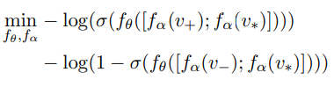
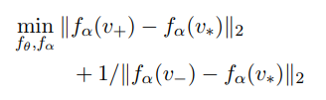
Methods——Cluster-Based Feature Compression
Triplet Noise-Contrastive Estimation
For each cluster in one particular cluster family, two semantic representations are randomly sampled, one as the pivot example v∗ and the other as the positive example v+. From the cluster in a different cluster family, another semantic representation is randomly selected as the negative example v−.
Triplet Distance Ranking
Word Prediction Loss
traditional word prediction NMT loss is used to train the Compact Network. In this scenario, the output dimension of f_θ is the vocabulary size of the corresponding target language.

Slide 19
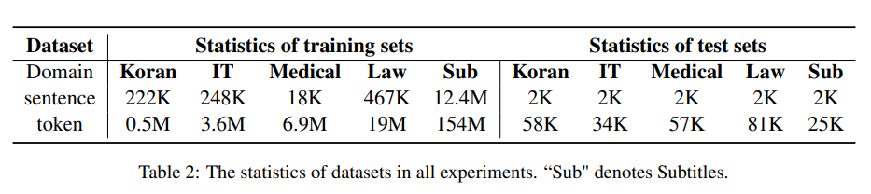
Experiments
adopt the original datastore to train Compact Network while the parameters of NMT are frozen.
adopt the validation set to train the Meta-k Network while the parameters of NMT and Compact Network are fixed.

Slide 20
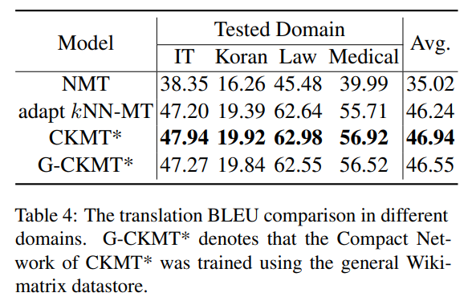
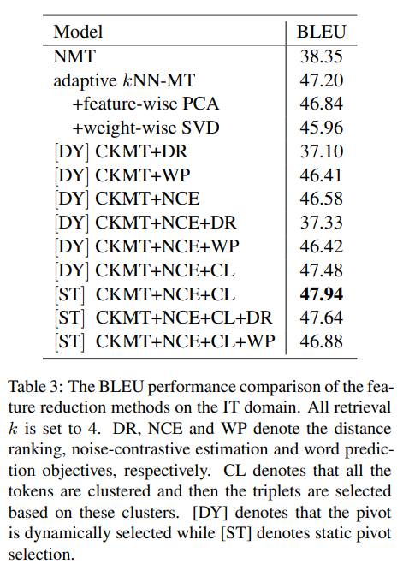
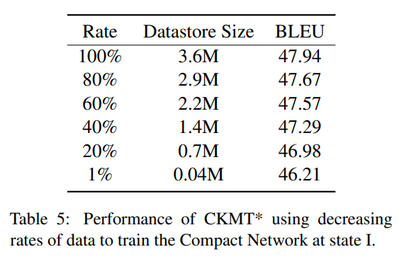
Experiments——Results
Notes:
Table3是总体的结果，Table4是Cross Domain Generalization的结果，Is there a general Compact Network that is capable to generalize to different domains？we trained the Compact Network in a general domain with the large-scale Wikimatrix Corpus (Schwenk et al., 2021) and evaluated its behavior on various target domains. Table5是The Compact Network Training with Limited Data的结果，When we use only 40% of the datastore for training, CKMT still outperforms the adaptive kNN-MT. It indicates that our proposed Compact Network is efficient and requires a small amount of key-value pairs to compress the semantic representations with contrastive loss.

Slide 21
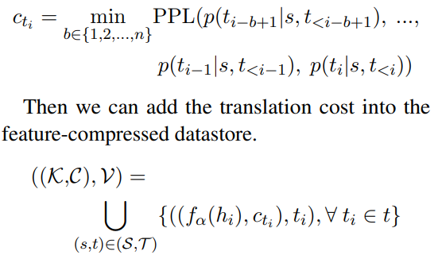
Methods——Cluster-Based Pruning
the number of pairs in the compressed datastore is crucial for latency.
Intuitively, the entry of a key-value pair in the datastore is redundant if there are other key-value pairs (with the same value) holding for that the difference of their perplexity (PPL) values is smaller than a given threshold epsilon.
measure the translation cost of its last token (desired value in datastore) as the perplexity (PPL) of the n-gram phrase.
search for the minimal PPL among all consecutive subsequences ending with that last token

Slide 22
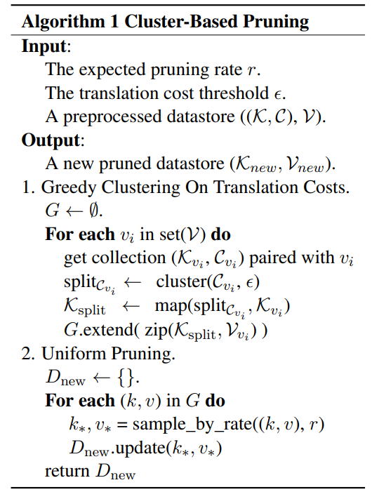
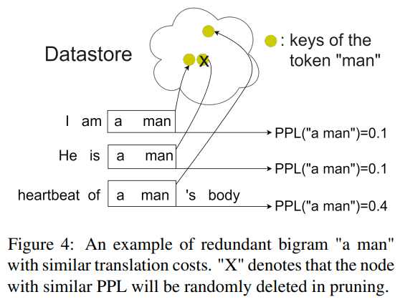
Methods——Cluster-Based Pruning Algorithm

Slide 23
Experiments——Performance of Pruning Methods
Spatially Pruning by Distance (SP). It is a naive pruning strategy using distance-wise solution by cutting off nodes with low probability according to the distance from each node to its cluster center.
Low Translation Probability Pruning (LTP). Tokens translated with low probabilities tend to have poor translation quality, and will be pruned for datastore stability.
High Translation Probability Pruning(HTP). As the kNN probabilities are beneficial for hart-to-translate words that NMT cannot handle, it would be more encouraged to restore the tokens wrongly translated by the base NMT. In this sense, tokens paired with high confidence will be pruned.
Random Pruning (RP). We also perform the random pruning strategy alone for the target-side clusters, as the step 2 introduced in Algorithm 1.

Slide 24
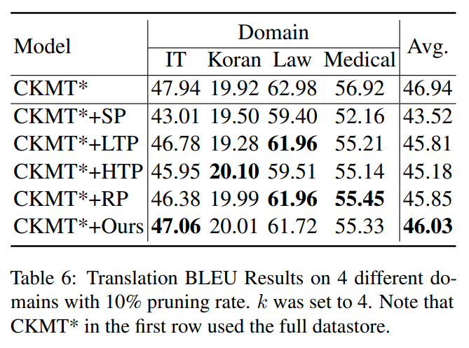
Experiments——Performance of Pruning Methods

Slide 25
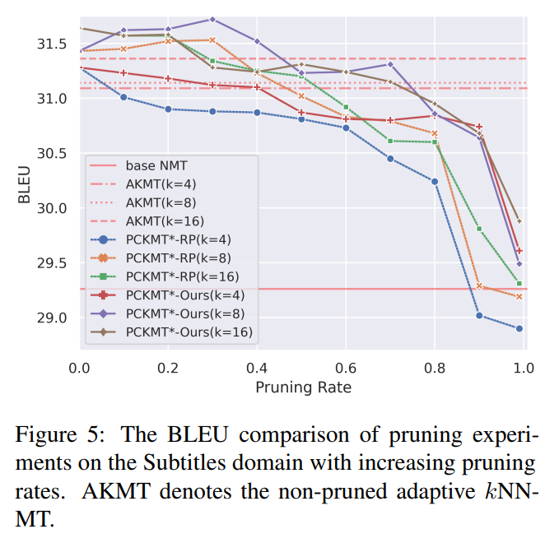
Experiments——Performance of Pruning Methods

Slide 26
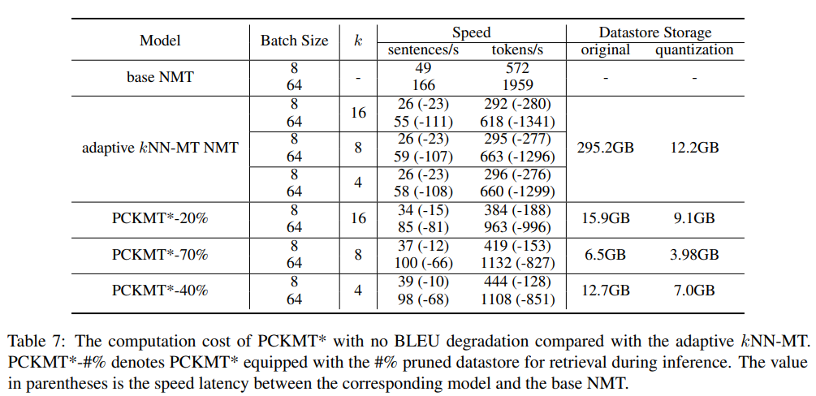
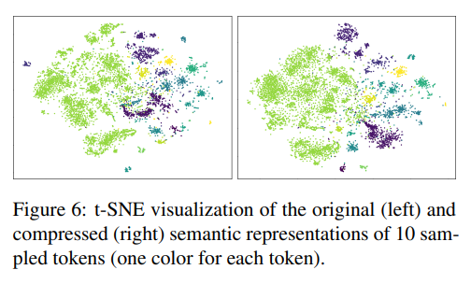
Experiments——Analysis

Slide 27
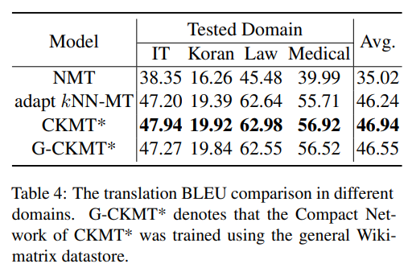
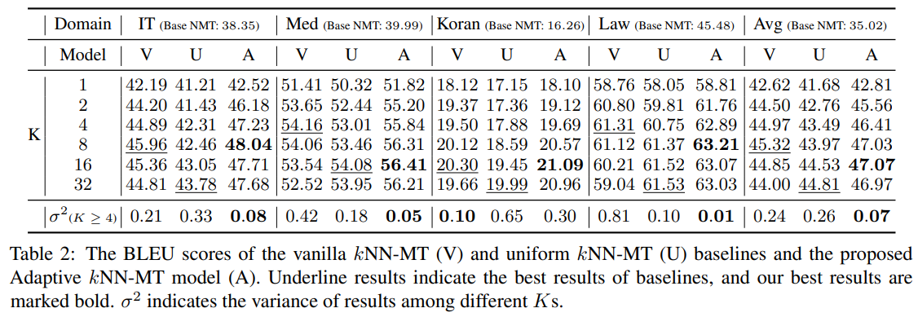
Immature comments
For adaptive kNN-MT, k=4 is a little bit small.
The methods are novel and environmentally
friendly with regard to dimension reduction and
datastore pruning.

Slide 29
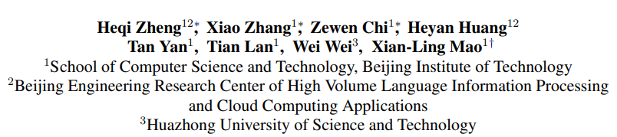
Cross-Lingual Phrase Retrieval
Introduction
Phrase retrieval aims to retrieve relevant phrases from a large phrase set, which is a critical part of information retrieval.
Recent studies on phrase retrieval achieve promising results in entity linking, slot filling, open-domain QA tasks, which are monolingual scenarios, leaving the cross-lingual phrase retrieval unexplored.
There are many methods to perform cross-lingual text retrieval, which learns cross-lingual word or sentence representations, leaving cross-lingual phrase retrieval an open problem.

Slide 30

Methods —— Model Architecture
The model architecture of XPR is a Transformer encoder shared across different languages. XPR can be initialized with pretrained cross-lingual language models.
Given a phrase p and an example sentence x with n tokens that contain the phrase. XPR first encodes x into a sequence of contextualized token representations. Then, the phrase is represented as the average of the phrase tokens.
In general, a phrase can have more than one example sentence, XPR uses the average of the phrase representations as the final phrase representation.

Slide 31
Methods——Cross-Lingual Phrase Contrast Loss
Consider a mini-batch B={P, Q} of bilingual phrase pairs, where P={p}_N and Q = {q}_N stand for N phrases in a language and their translations in another language.
For each phrase p ∈ P, we sample example sentences X for p, and compute the phrase representation u.
Apply a projection head over u that consists of two linear layers with a ReLU in between and a l_2 normalization followed.
For simplicity, p = f(p, X ; θ)

Slide 32
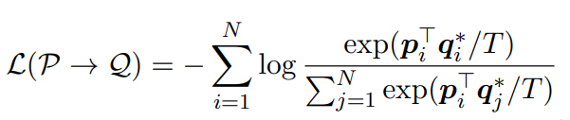

Methods——Cross-Lingual Phrase Contrast Loss
For each phrase q ∈ Q, we employ a momentum encoder to encode q. q∗ = f(q, Y; θ_m)
For the i-th phrase p_i ∈ P, q_i ∈ Q is its corresponding positive example and the other N−1 phrases are treated as negative examples.
The contrastive loss in the direction of P → Q is defined as:
Similarly, we employ an additional contrastive loss in the direction of Q → P. The XPCO loss combines both directions:

Slide 33
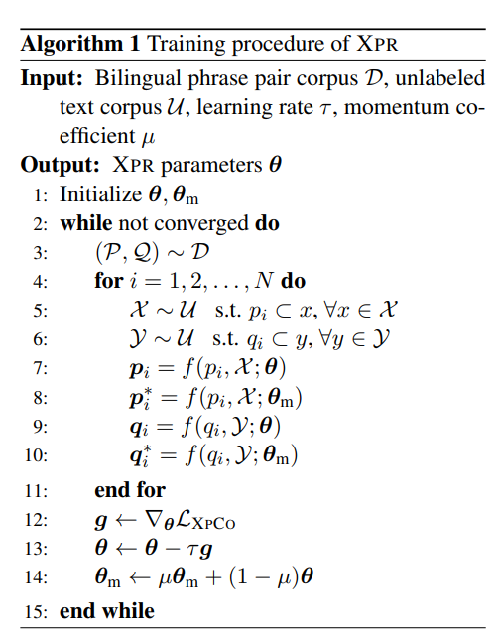
Methods——Training Procedure of XPR

Slide 34

Methods——Phrase Retrieval with XPR
Given a phrase set P = {p}_N with N candidate phrases , the goal is to find p ∈ P with the same meaning of a query phrase q.
With the trained XPR encoder θ, we first sample example sentences for candidate phrases and then compute their representations {p}_N with f(·; θ). Then, for a query phrase q, we can find the corresponding phrase by:

Slide 35
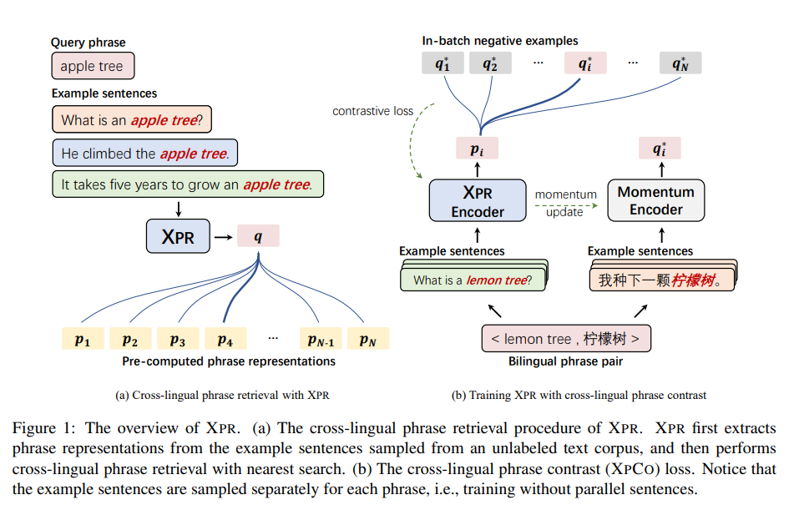

Slide 36
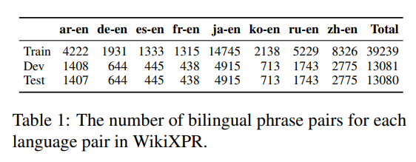
WikiXPR: Cross-Lingual Phrase Retrieval Dataset
WikiXPR consists of bilingual phrase pairs in eight English-centric language pairs, and contains large-scale example sentences for the phrases
Phrase Pair Mining: leverage the link information within Wikipedia for mining bilingual phrase pairs. Specifically, we extract inter-language linked wiki entries from dbpedia.
Example Sentence Retrieval: we first extract raw sentences from Wikipedia dumps as unlabeled corpus. Then, we build sentence indices with the Elasticsearch. We retain sentences with at least 10 more characters than the phrase and only retain 32 example sentences for each phrase.

Slide 37
Experiments——Evaluation Settings
Unsupervised: the retrieval model should not use any bilingual phrase pairs or other cross-lingual supervision such as bilingual dictionaries and parallel corpus. The language representations are typically learned from unlabeled text corpora.
Supervised: the retrieval model is trained on and tested on bilingual phrase pairs for each language pair separately.
Zero-Shot Transfer: e.g., training a model with English-French phrase pairs but performing retrieval between English and Chinese phrases.
Multilingual Supervised: training a model using a combined training set over all languages in WikiXPR and testing it for each language.

Slide 38
Experiments——Baselines
CLWE: Cross-lingual word embeddings (CLWE) encode words from various languages into a shared embedding space. For each word in a phrase, we first represent it with the pretrained fastText multilingual word vectors, and then map it to a shared embedding space via the VECMAP tool. Finally, the retrieval is achieved by the nearest search using an average word vector as the phrase representation.
CLSE: Cross-lingual sentence encoders (CLSE) produce language-agnostic sentence representations for the input text sequence. We use XLM-R_{base} as the sentence encoder.
Initialize XPR with XLM-R_{base} for a fair comparison.

Slide 39
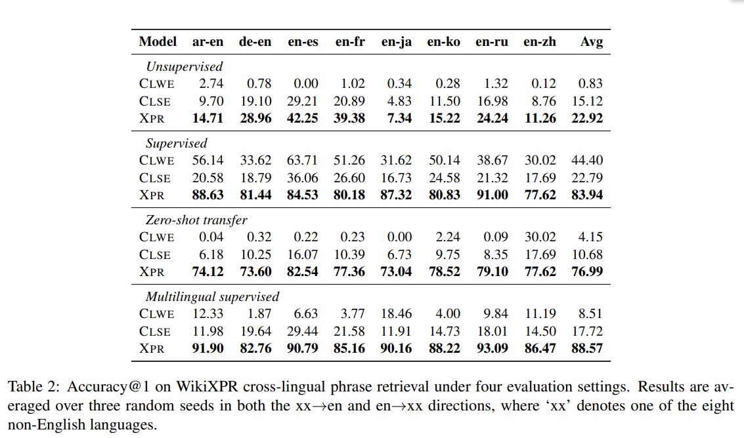
Experiments——Results

Slide 41
THANK YOU

